Slide 1
Project Time Tracker
By Stewart Locke

Slide 2
About me
Stewart Locke
Work for MAPS (Management And Professional Services)
Work as a software developer at MAPS since 2017

Slide 3
About the project
Improve upon existing system
Tracks time against project tasks
Built in:
C#
Blazor
.Net Core
Entity Framework Core
SQL server
Aim to improve usability
Add reports
Add other useful features

Slide 4
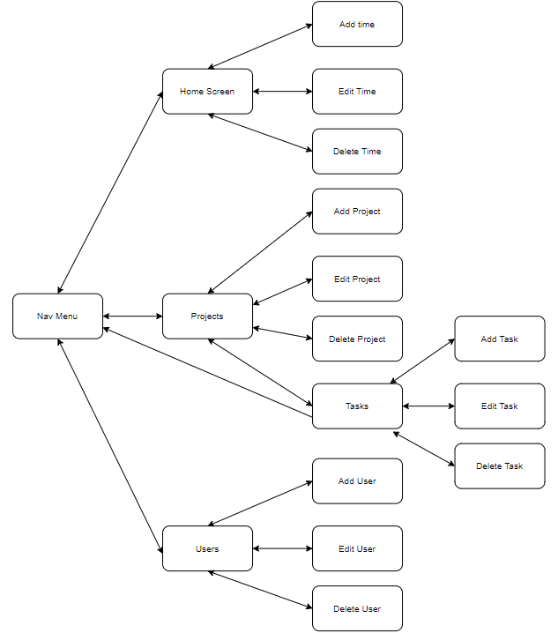
Current System
User management
Create projects
Edit projects
Add tasks to projects
Add time against project tasks
View Personal time spent
Edit time spent

Slide 5
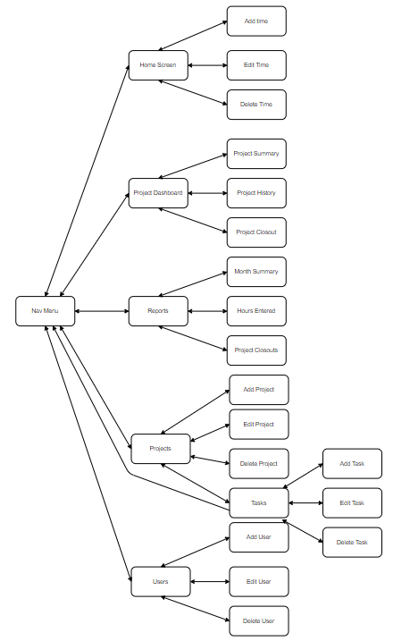
Planned Changes
Add project templates
Add project dashboard
Project summary
Project history
Comments
Add project closeouts
Add reports
Month summary
Hours entered
Project closeouts

Slide 6
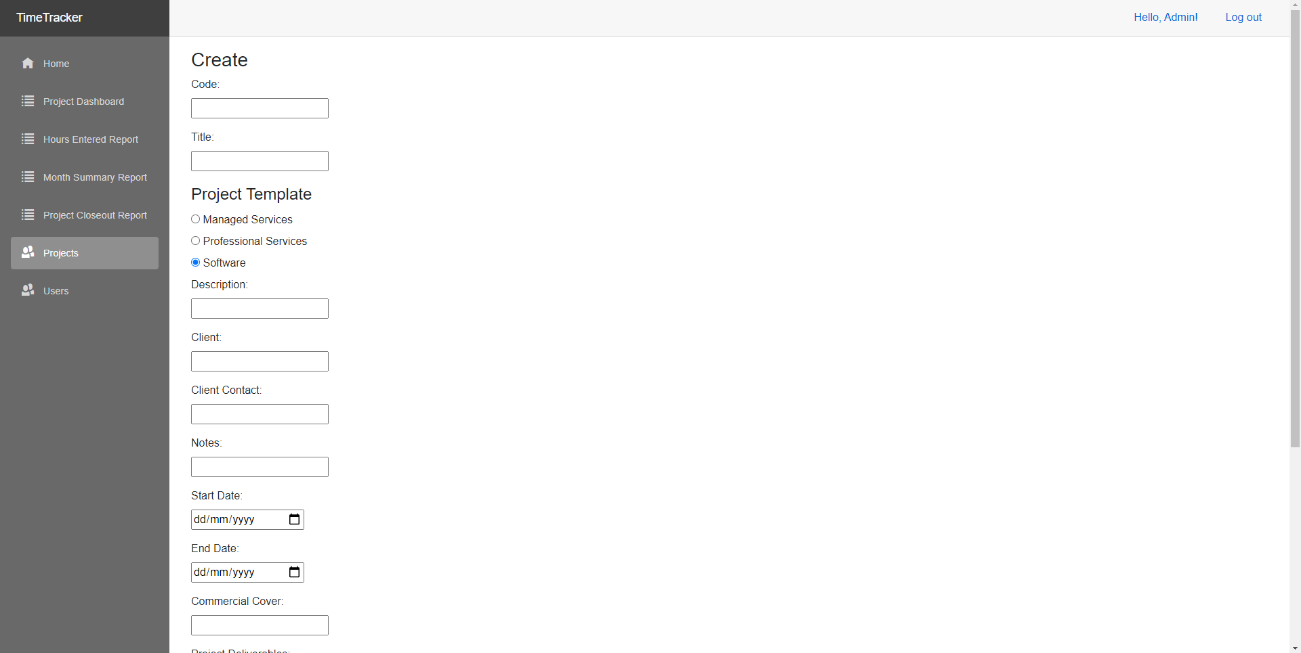
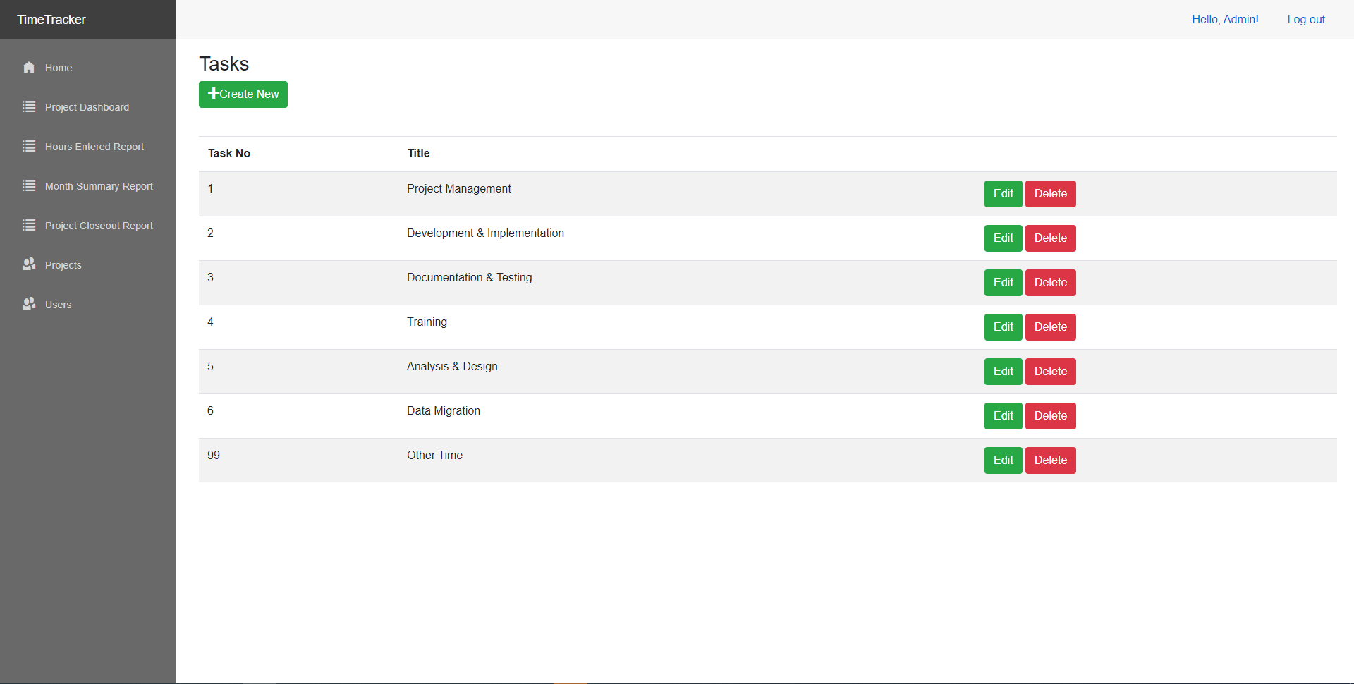
Project Templates
Add ability to select a project template type which automatically sets up default tasks.

Slide 7
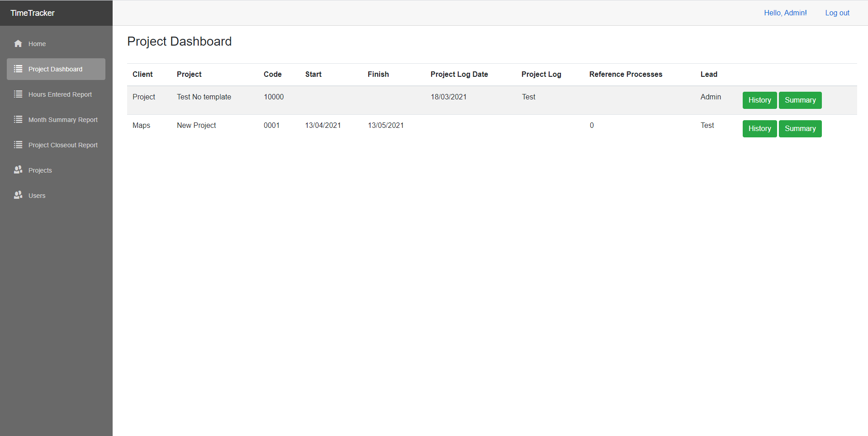
Project Dashboard
The project dashboard shows all current projects and give access to the project summary, project history and comments

Slide 8
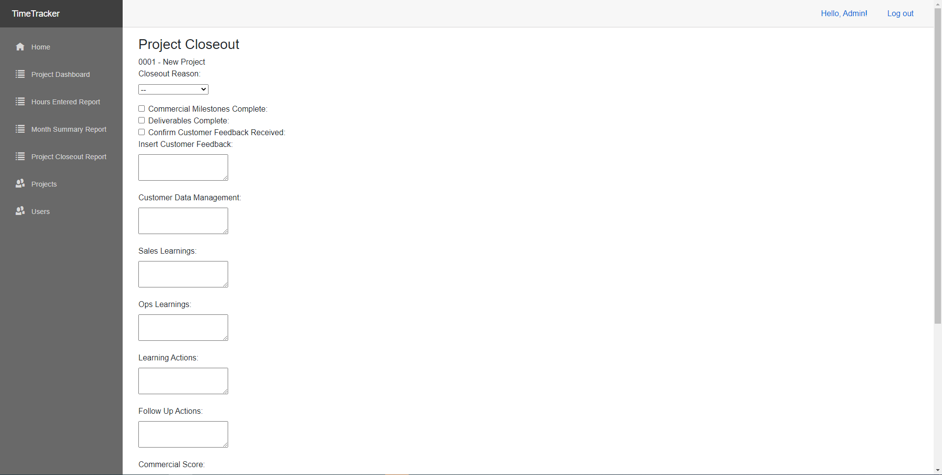
Project Closeouts
At the end of projects lifecycle it goes through the closeout process.

Slide 9
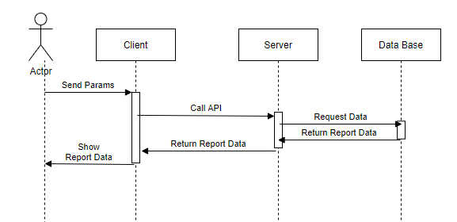
Reports
The updated system added three new reports
Month summary
Hours entered
Project closeouts

Slide 10
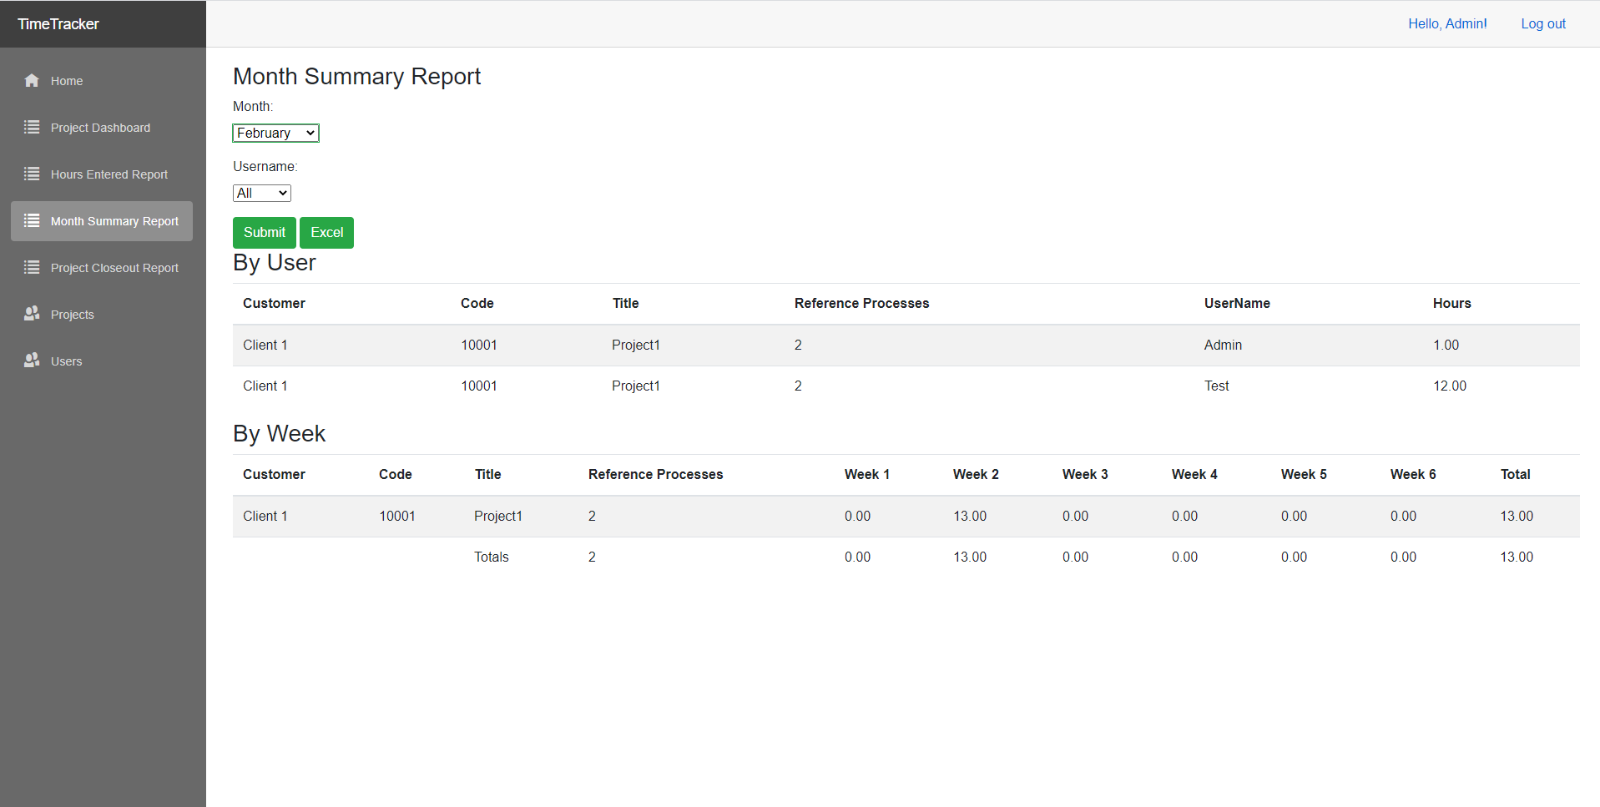
Month summary
Displays the hours against each project in a given month

Slide 11
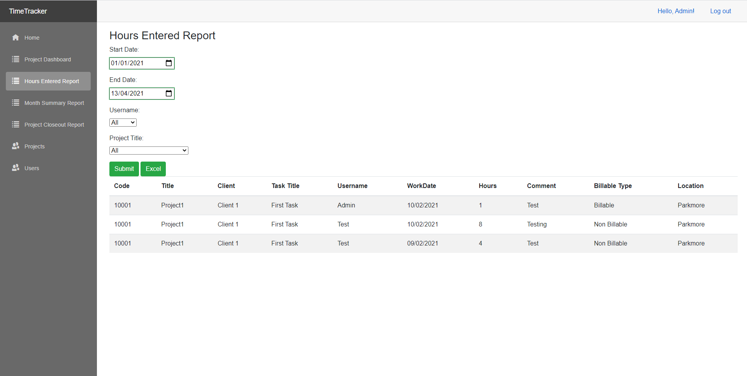
Hours entered Report
Displays the Hours entered into the system between dates.

Slide 12
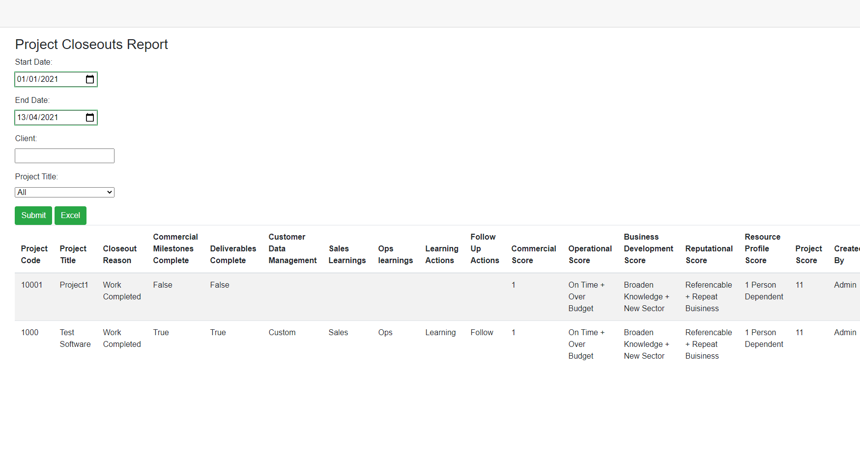
Project closeouts
Shows all project closeout details between 2 dates

Slide 13
Conclusion
Project deliverables met
Experienced smooth development with minor difficulties
Developed my skills with Blazor, .Net Core and design
System deemed complete further development needed
Any Questions!

